Slide 1

Data Visualization CA2 Dimensionality reduction using UMAP
Monika Tambe(10523237)
Adit Deshpande
Aliasgar Electricwala(10532445)

Slide 2
Introduction
Dimensionality Reduction:
Dimensionality reduction is conversion of high dimensional space into the low dimensional space so that the low dimensional representation retains some meaningful features of the original data.

Slide 3
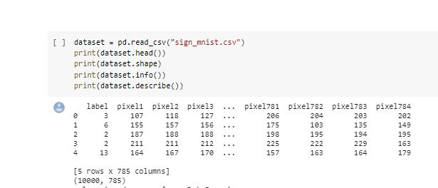
Dataset Description
As we see below image of the dataset there are total number of rows 10000 & total number of columns are 785. Following is the image for dataset

Slide 4
Dimensionality reduction techniques
1.t-SNE:
t-Distributed Stochastic Neighbour Embedding
2. UMAP:
Uniform Manifold Approximation and Projection

Slide 5
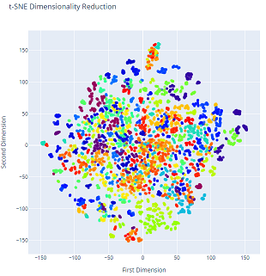
T-SNE
As we use t-SNE technique for our project it is observed that the visualization is not cleared because, in the graph the digits appears in a very disorder form.
Another disadvantage of t-SNE method is it takes very long time for execution.
To overcome these problems we used another method that is UMAP.
The graph of t-SNE technique is as follows:

Slide 6
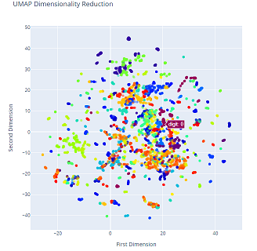
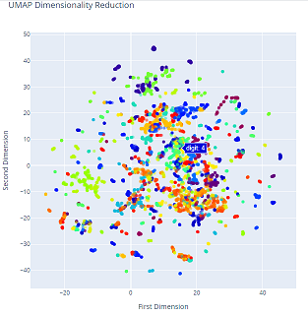
UMAP
After using UMAP technique we get the clear graph of digits forming cluster of similar digits within seconds.
The graph of UMAP is as follows:

Slide 7
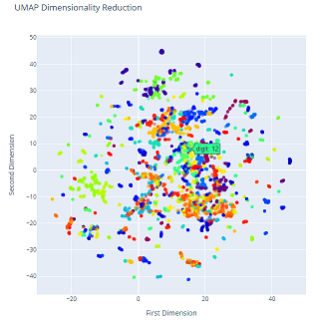
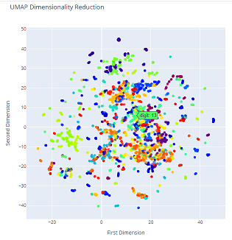
UMAP(Continued)

Slide 8
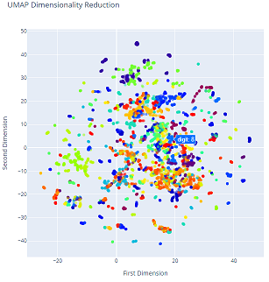
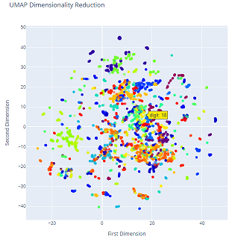
UMAP(Continued)

Slide 9
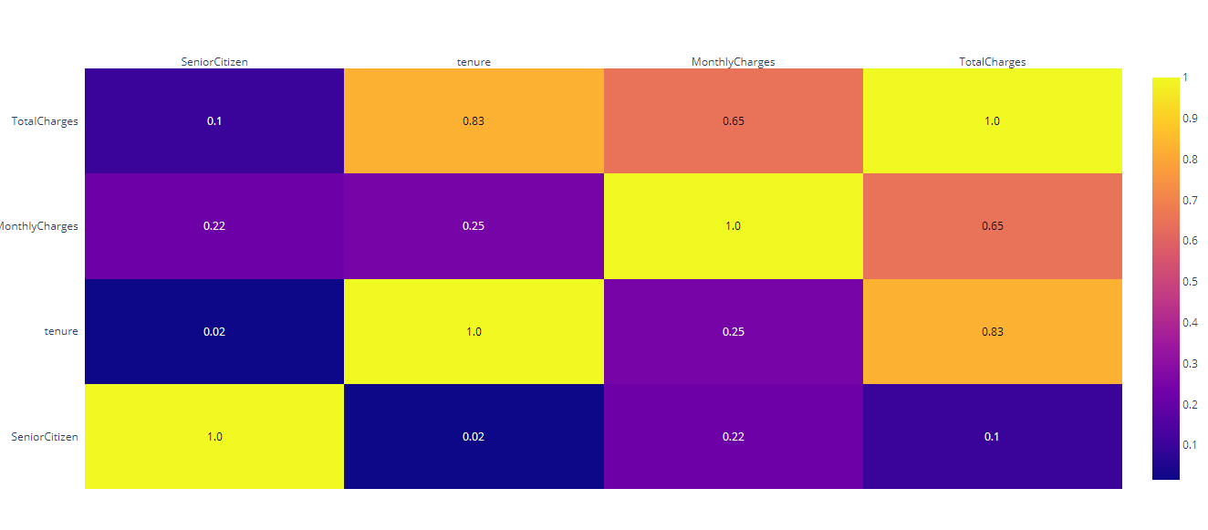
Dataset 2:
Second Dataset is about the Customers of a Telecom company.
In this data first the correlation heatmap of numerical data is found.
It has around 15 Categorical variables.

Slide 10
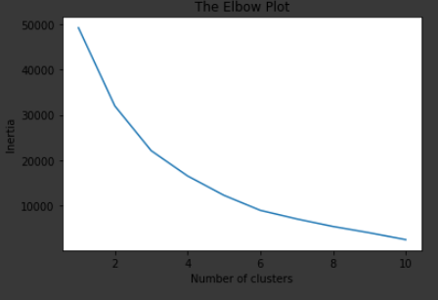
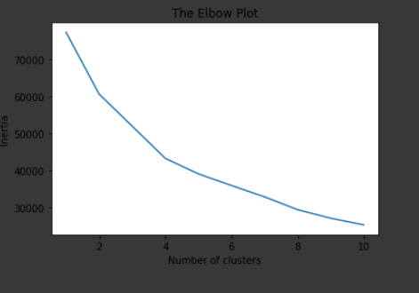
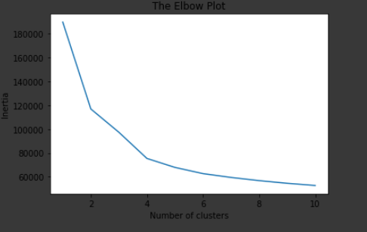
Dataset Divided into 3 subsets
The dataset was divided into 3 subsets and then normalized.
Further the analysis was performed on all the three subsets and elbow was constructed to find number of clusters in subsets.
Elbow Plot for Subset 1
Elbow Plot for Subset 2
Elbow Plot for Subset 3

Slide 11
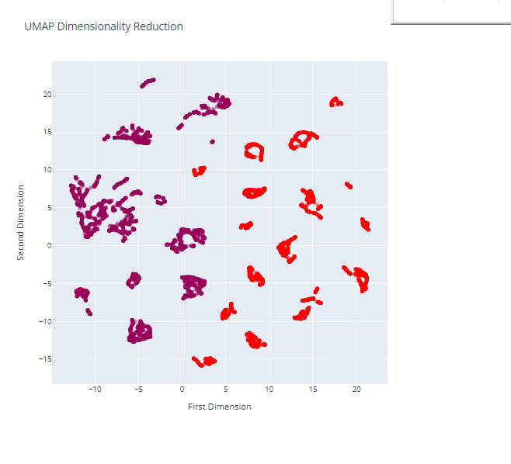
UMAP Visualizations For 3 Subsets

Slide 12
Thank You

